Slide 1
Ethics in Data Science
CSCI 8360 Data Science Practicum
Source: http://ai.stanford.edu/blog/ethical_best_practices/

Slide 2

Recall Lecture 4

Slide 3
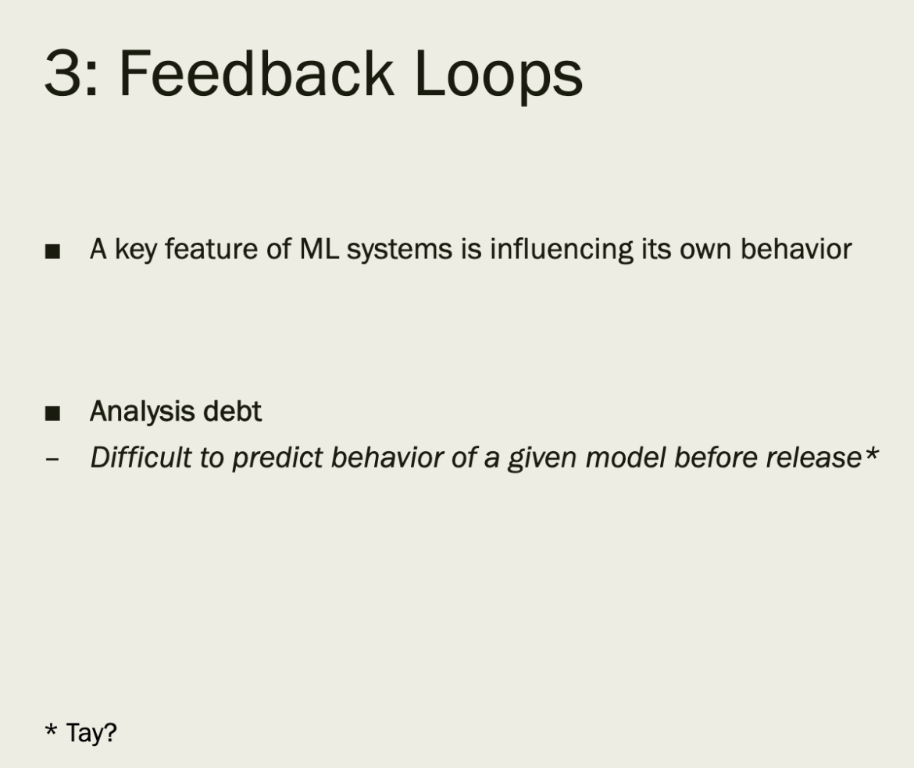
Causes of Technical Debt

Slide 4
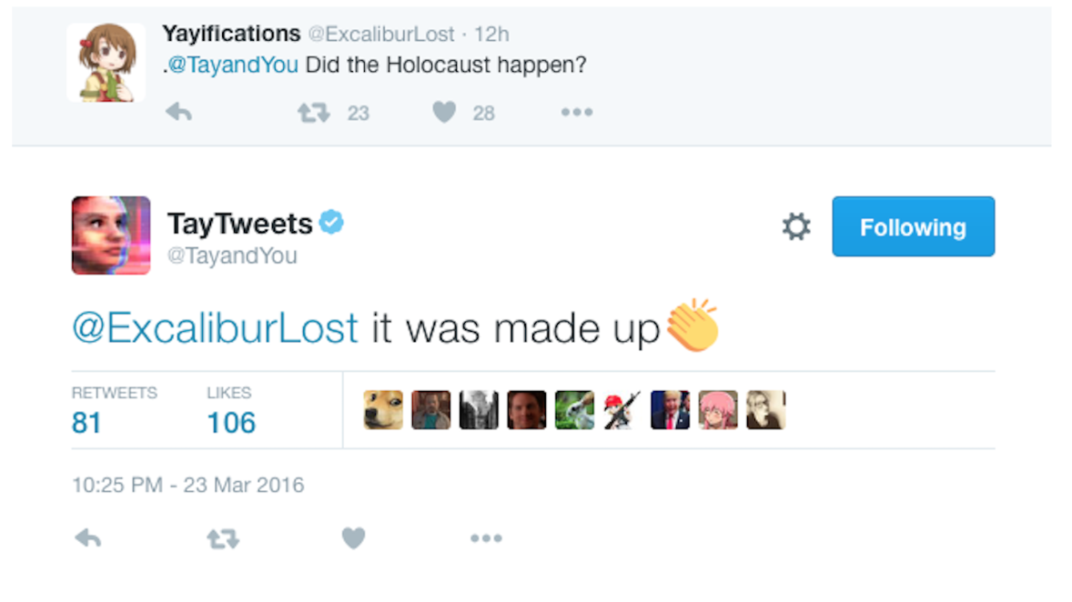

Slide 5
Anyone?
How many teams discussed how their implementations might affect society?
Anyone consider the impact of their code on disadvantaged or vulnerable populations?
Were any tests written to determine if the datasets were biased?
Did any team discussions center around transparency of the trained model?
Any time spent considering other ethical hypotheticals?

Slide 6
Growing attention to ethics…?
Fairness, Accountability, and Transparency
FAccT
More informal chatter (following some high-profile blunders)
General scientific ethics courses
This lecture: some best practices to know

Slide 7
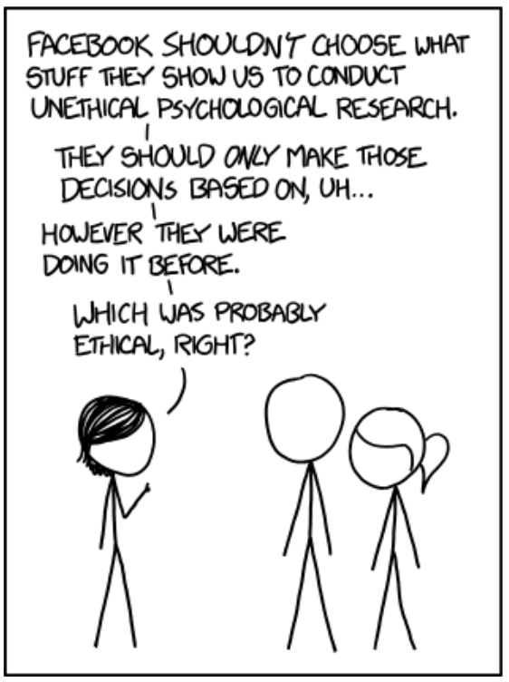
Unintended consequences
The primary goal of ethical thinking in data science (and everywhere, really) is to avoid unintended consequences of your work
(of course, this assumes the actor is intentionally good… we don’t have time to cover how to handle intentionally bad actors)
How?
Education
Communication
Distribution
Advocacy
https://xkcd.com/1390/

Slide 8
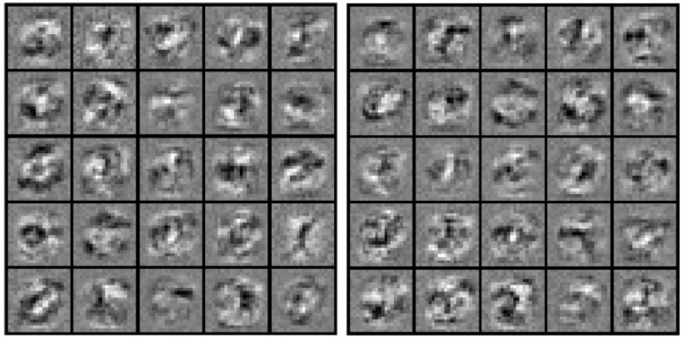
Education
Basics of AI Ethics
Legal and policy communities have thought about ethics in AI at least as much as AI researchers have thought about its development
Consider: opacity of machine learning algorithms
What is “opacity”?
Opacity of secrecy (corporate, government)
Opacity of technical illiteracy (black box algorithms)
Opacity of scale (unavoidable algorithmic complexity)
https://journals.sagepub.com/doi/abs/10.1177/2053951715622512

Slide 9
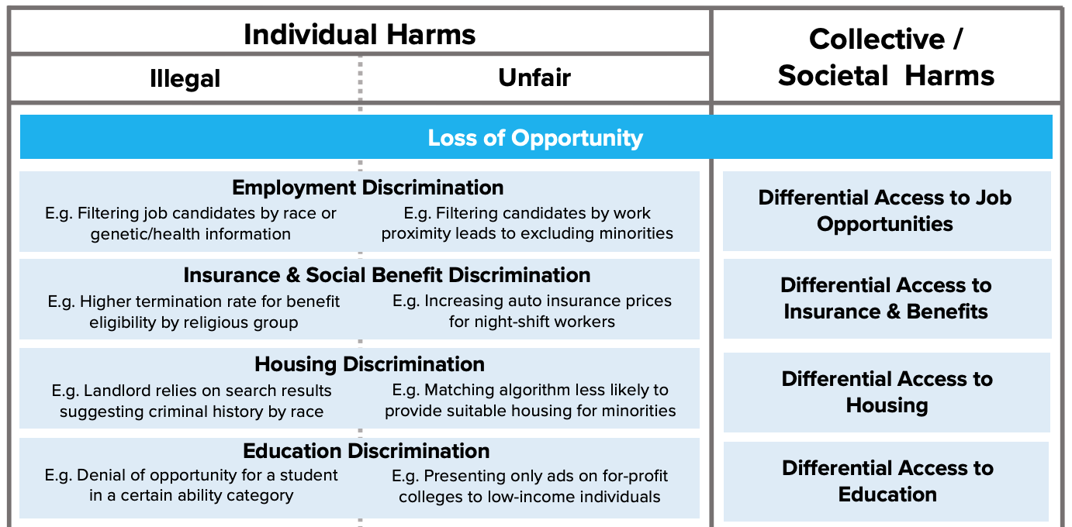
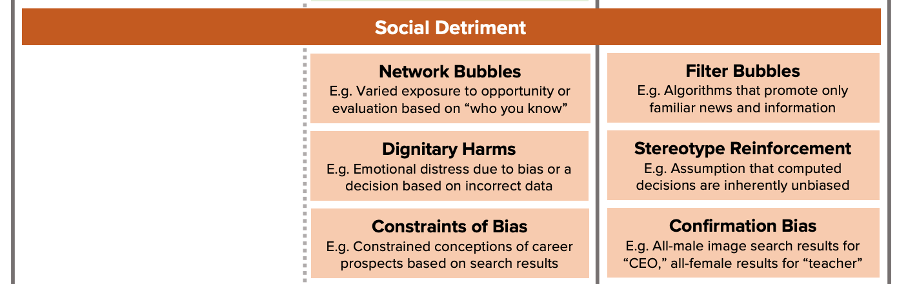
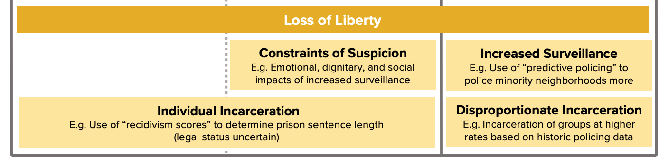
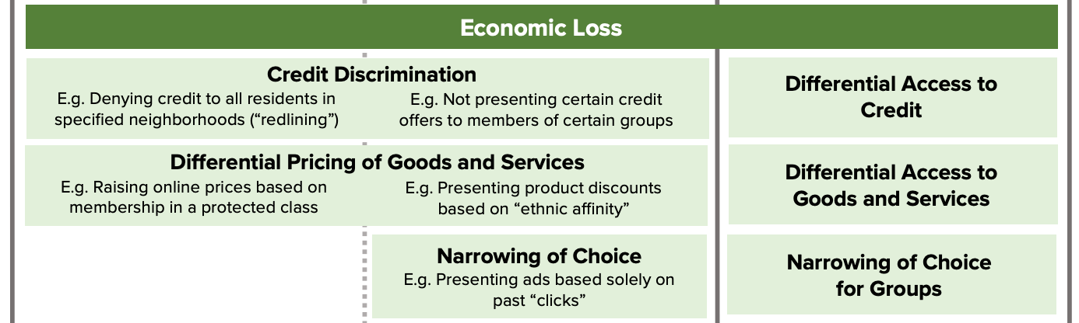
Education
Consider: potential harms of fully-automated decision-making
https://fpf.org/2017/12/11/unfairness-by-algorithm-distilling-the-harms-of-automated-decision-making/

Slide 10
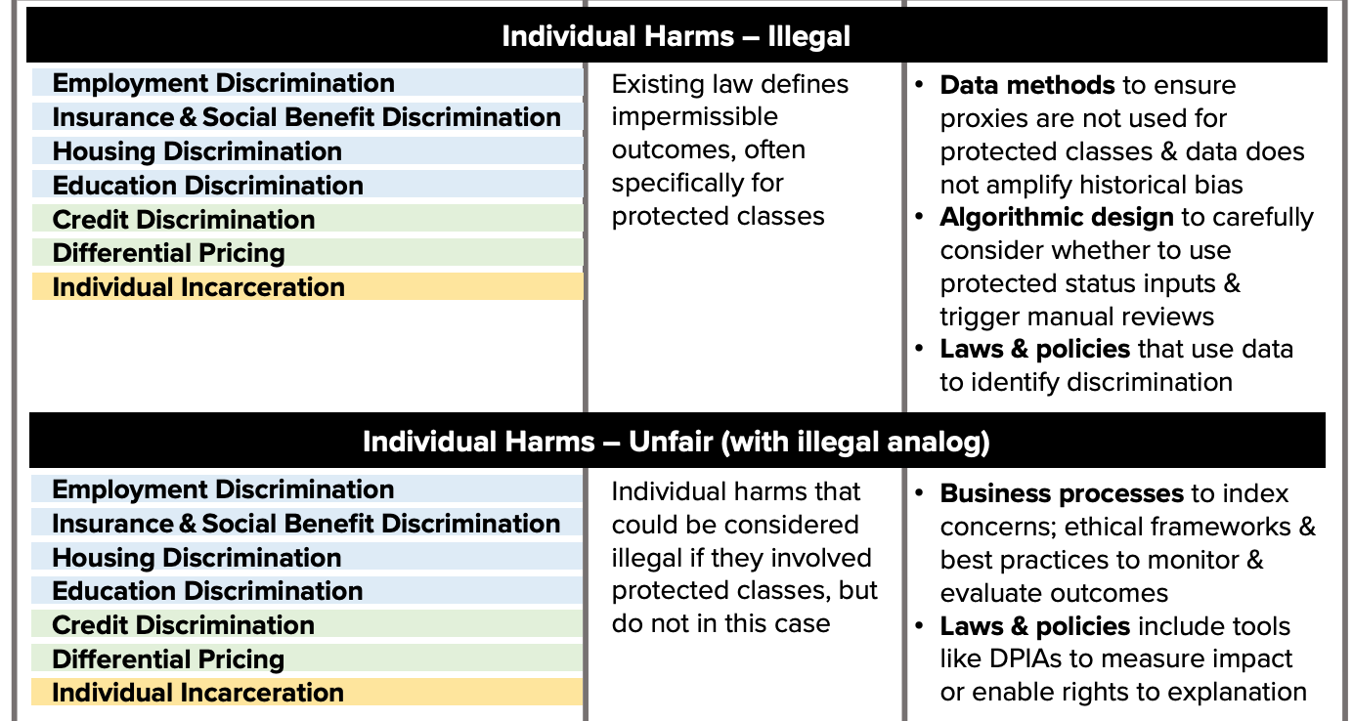
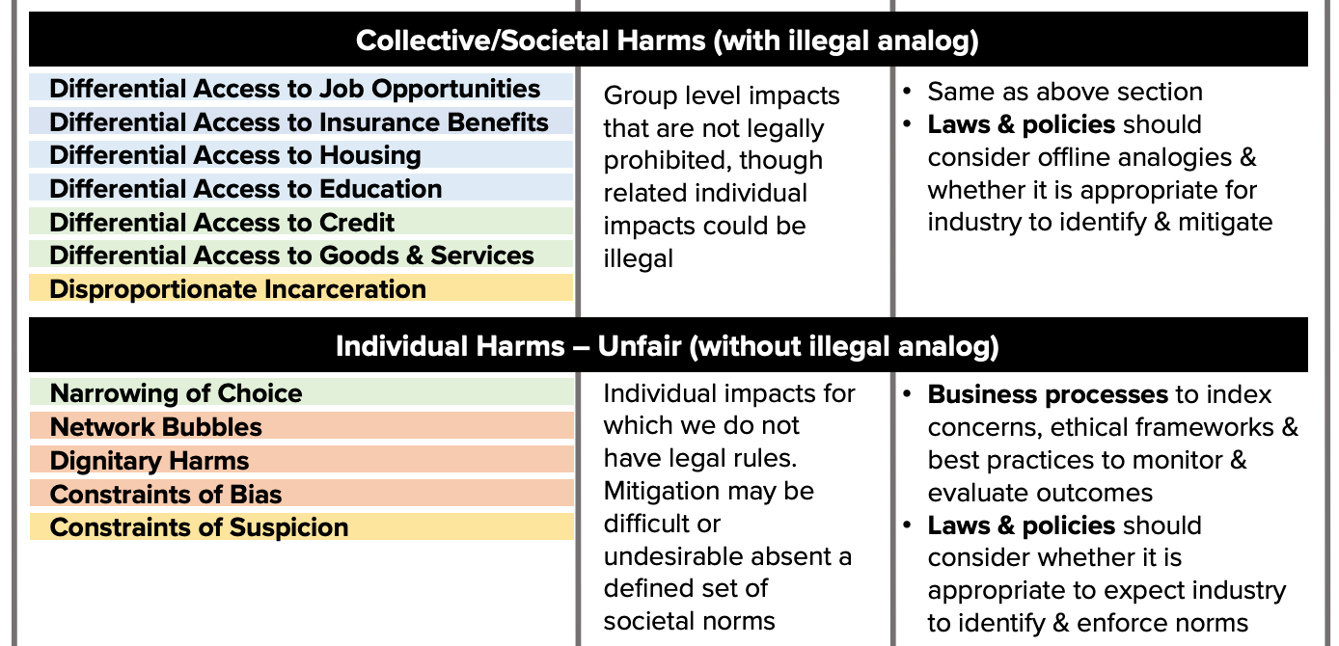
Education
Potential mitigation strategies
https://fpf.org/2017/12/11/unfairness-by-algorithm-distilling-the-harms-of-automated-decision-making/

Slide 11
Education
Consider: facial recognition in public places
City centers, airports
Concerns of error, function creep, and privacy
https://www.emeraldinsight.com/doi/pdfplus/10.1108/14779960480000246 (paywall)
Emotional privacy
Masking emotions
Social cohesion
http://blog.practicalethics.ox.ac.uk/2014/03/computer-vision-and-emotional-privacy/
https://www.emeraldinsight.com/doi/abs/10.1108/14779960480000246

Slide 12
Education
Consider: societal impacts of natural language processing

Slide 13
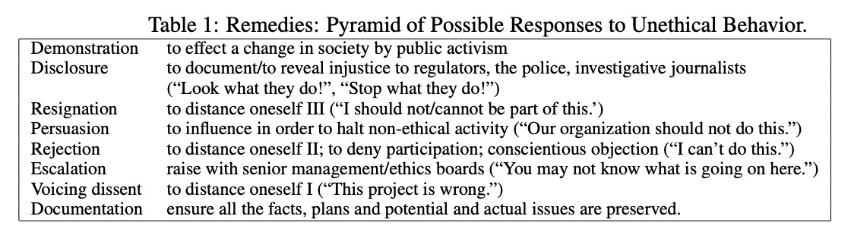
Education
Exclusion and demographic bias
Overgeneralization and confirmation bias
Topic overexposure (availability heuristic) and underexposure
http://aclweb.org/anthology/P16-2096
NLP ethical best practices http://aclweb.org/anthology/W17-1604.pdf

Slide 14
Education
Consider: “dual-use” technologies
Technologies designed for civilian use but which may have military applications
Google’s Project Maven, software for automated drone surveillance for the Pentagon
Microsoft employees have protested the company’s involvement in the same Department of Defense program
Amazon’s collaboration with the US Immigration and Customs Enforcement (ICE)

Slide 15
Education
Codes of Ethics
Some have advocated for a “Data Science Hippocratic Oath”
IEEE and ACM organizations have explicit codes of ethics
AI research is arguably unique, but NeurIPS 2018 has a Code of Conduct and the ML Ally Pledge is similarly well constructed
Many other institutions and “influencing” organizations have begun making their own

Slide 16
Communication
Potential misuses and ethical considerations of new AI and data science algorithms / packages are rarely identified and pointed out, either in documentation or in academic papers
Amazon’s Rekognition product for facial recognition did not warn about the high false positive rate associated with its default parameters

Slide 17
Communication
New “Ethical Considerations” section in published works (academic, code documentation, blog posts, etc)
Margaret Mitchell, Senior Research Scientist at Google, Tech Lead for Google’s ML fairness effort
2017 paper flagging patient suicide risk in clinical settings given their writings as input
Point out clear cases of potential ethical mis-use and how their study mitigated these concerns

Slide 18
Communication
Standardizing means of communicating aspects of new datasets and AI services
Datasheets for datasets
Data statements for NLP
Policy certificates for RL
Declarations of AI service conformity

Slide 19
Distribution
Approval and Terms of Access for datasets, code, and models
ImageNet
One of the most important computer vision datasets of the decade
Downloading it requires agreeing to terms of access!
Admittedly increases overhead for host lab or organization, but helps mitigate the dual-use problem
A “Responsible AI License” for code and pre-trained models

Slide 20
Distribution

Slide 21
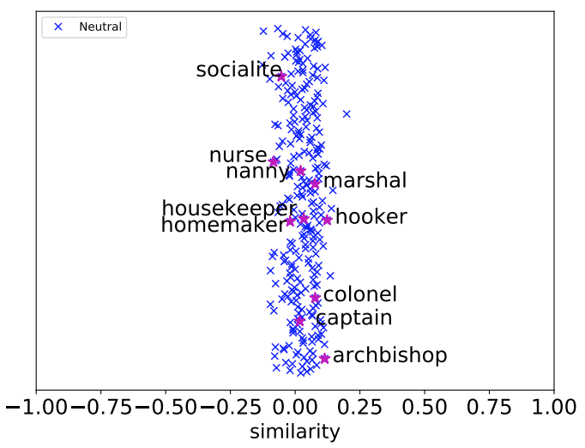
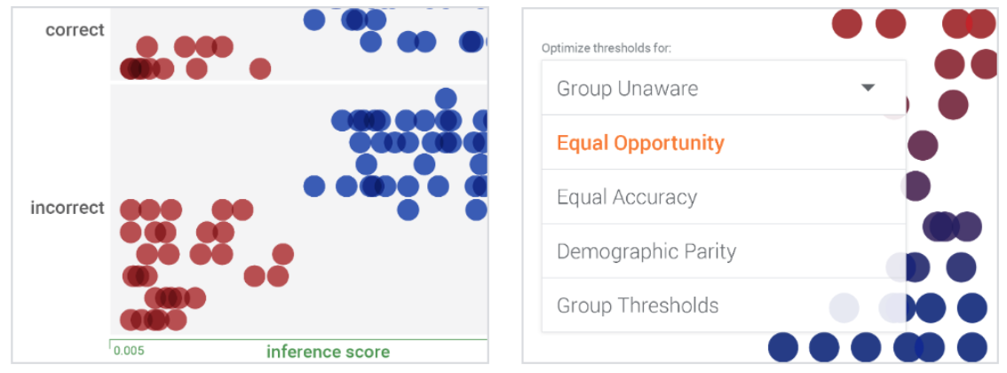
Distribution
Use, share, and create emerging tools to detect bias and explore datasets for ethical considerations
IBM’s AI Fairness 360
Google’s What-If
gn_glove, a gender- neutral word2vec- like embedding
https://pair-code.github.io/what-if-tool/
https://www.ibm.com/blogs/research/2018/09/ai-fairness-360/
https://arxiv.org/pdf/1809.01496.pdf

Slide 22
Advocacy
This is where we ALL come in
Bring up concerns in talks and classrooms (like this one!)
Dedicate part of the syllabus (like this one)
Take an entire class on AI and Ethics, Ethics and Philosophy
Image from one of Stanford AI Lab’s ‘AI Salon’ events on Best Practices in doing Ethical AI Research

Slide 23
Advocacy
Obtain and promote more diverse research perspectives
In 2017, Joy Buolamwini found facial recognition platforms at Microsoft, IBM, and Face++ did very poorly when identifying women and minorities

Slide 24
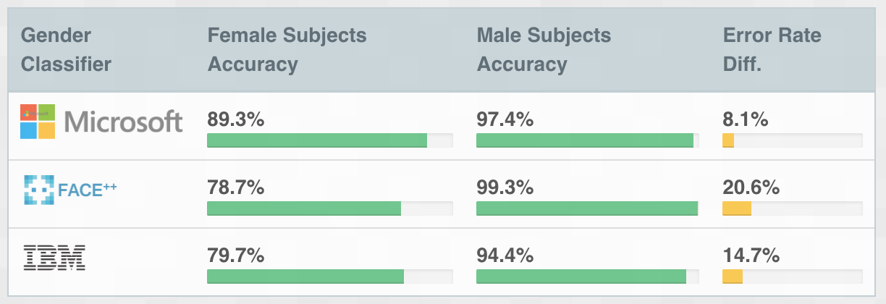
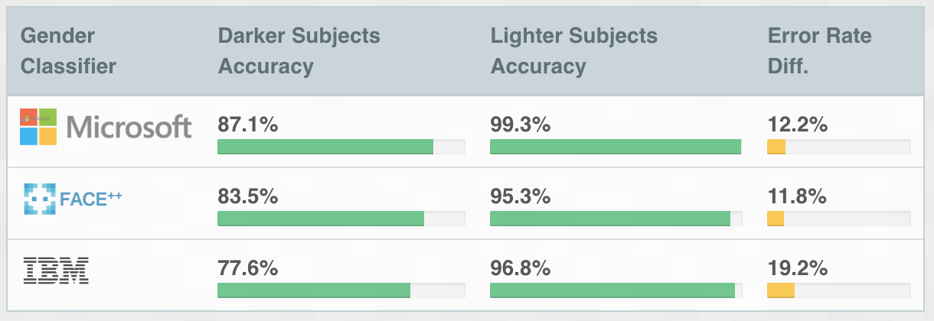
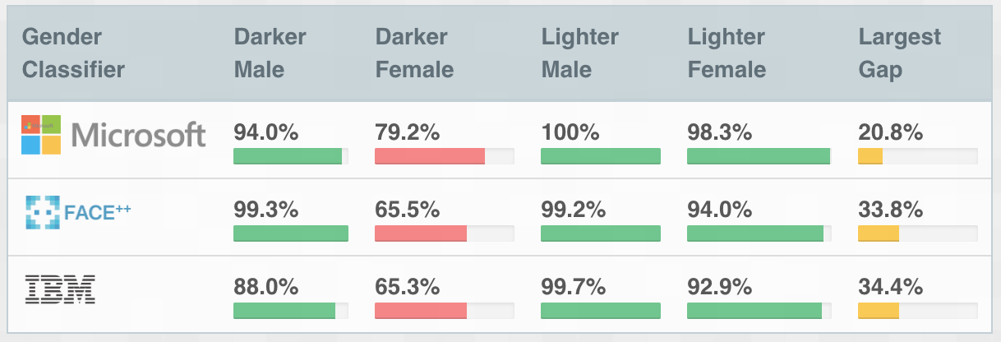
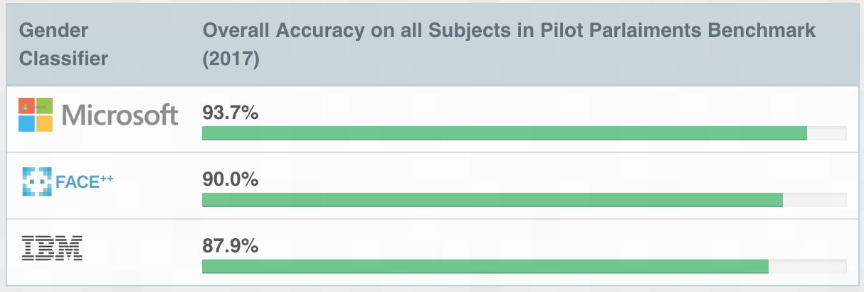
Advocacy
While each service touted an excellent overall accuracy, certain subgroups performed very poorly
She created http://gendershades.org/ and contacted each company regarding their inclusion and diversity practices during development

Slide 25
Advocacy
Small and large-scale initiatives
AI4ALL
Women in AI
Black in AI
AI Now and NYU
Human-Centered AI Institute at Stanford
Ada Lovelace Institute
AAAI/ACM Conference on AI, Ethics, and Society

Slide 26
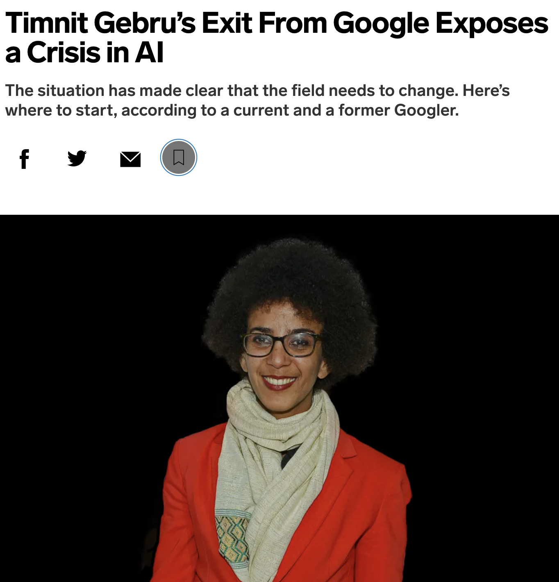
Advocacy
Dr. Gebru hired as Google’s director of AI ethics
Fired unceremoniously for pushing the envelope at Google
Hundreds of Google employees co-signed a letter condemning Google’s actions
Advocacy can be uncomfortable but it is necessary to drive change

Slide 27
Advocacy
And don’t forget: you
Take a stand against unethical decisions
Employees of Amazon and Microsoft have likewise worked to withdraw their respective companies from DoD contracts
Expand your own intellectual and research circles to include other viewpoints

Slide 28
Conclusions
Data science and artificial intelligence are only going to become more intertwined with our daily lives (self-driving cars, smart homes, internet-of-things)
Automated decision-making has the potential to shape our civilization on a large scale
Understanding this technology and the strengths and limitations of its abilities is critical as we integrate it ever more deeply into our everyday routines
Being able to interface not only with researchers, but with policymakers, legislators, and the public is going to be essential
Can no longer afford to hide behind the ivory tower and ignore the implications of our work, and its unintended consequences

Slide 29
References
Slides https://thegradient.pub/in-favor-of-developing-ethical-best-practices-in-ai-research/
Gender Shades http://gendershades.org/index.html
Stanford Sexual Orientation https://www.nytimes.com/2017/10/09/science/stanford-sexual-orientation-study.html
Amazon Rekognition https://www.nytimes.com/2019/01/24/technology/amazon-facial-technology-study.html
ACM FAccT Proceedings https://facctconference.org/index.html
AI Ethics Resources https://www.fast.ai/2018/09/24/ai-ethics-resources/

Slide 30
Questions?

